Slide 1
Deep Learning and Logic
...
William W Cohen
Google AI/Carnegie Mellon University
joint work with
Fan Yang, Zhilin Yang, Kathryn Rivard Mazaitis

Slide 2
Clean understandable elegant models
Complexity of real-world phenomena
⇒
complex models
⇒
lots of programming or data
Notes:
Logic is elegant, but the real world is complex

Slide 3
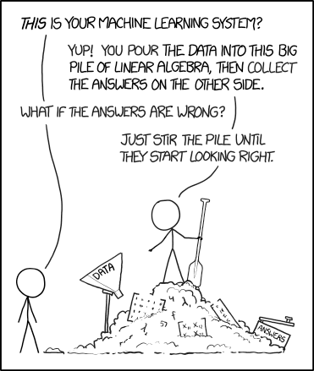
Complexity of real-world phenomena
⇒
complex models
⇒
lots of programming or data
How did we get here?
Notes:
Logic is elegant, but the real world is complex

Slide 4
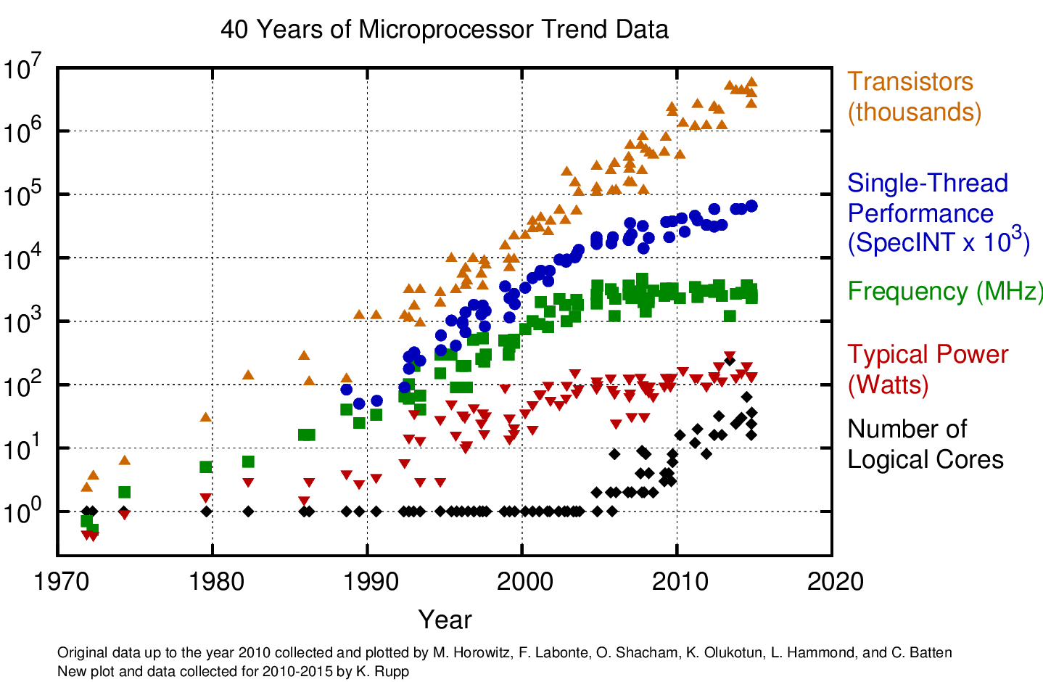
Notes:
Logic is elegant, but the real world is complex

Slide 5
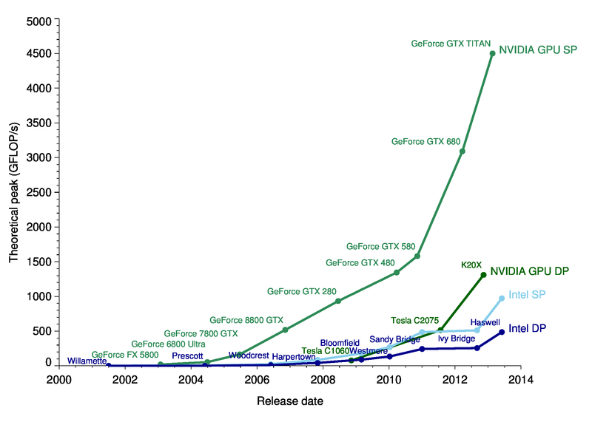
2017: 45 Teraflops
(45,000 GFLOPS)
How did we get here?
Notes:
Logic is elegant, but the real world is complex

Slide 6
run Hadoop, Spark, ...
How did we get here?
run a big pile of linear algebra
Notes:
Logic is elegant, but the real world is complex

Slide 7
Deep Learning and Logic:
Learnable Probabilistic Logics
That Run On GPUs
Clean understandable elegant models
complex models
Notes:
Logic is elegant, but the real world is complex

Slide 8
Tensorlog:
Key ideas and background

Slide 9
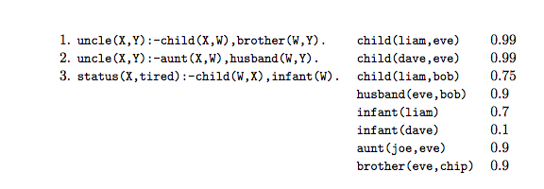
Probabilistic Deductive DBs
Horn clauses (rules)
ground unit clauses (facts)
weight for each fact

Slide 10
Probabilistic Deductive DBs
status(X,tired) :- child(W,X), infant(W), weighted(r3).
We use this trick to weight rules
weighted(r3) 0.98
special fact only appearing in this rule
special fact only appearing in this rule

Slide 11
Probabilistic Deductive KGs
(Knowledge Graphs)
Assumptions:
(Only parameters are weights for facts)
Predicates are unary or binary
Rules have no function symbols or constants

Slide 12
Neural implementations of logic
KBANN idea (1991): convert every DB fact, and every possible inferable fact, to a neuron.
Similar “grounding strategies” are used by many other soft logics: Markov Logic Networks, Probabilistic Soft Logic, …
A neuron for every possible inferable fact is “too many” --- i.e., bigger than the DB.

Slide 13
Reasoning in PrDDBs/PrDKGs
uncle(liam,dave)
uncle(liam,eve)
uncle(liam,chip)
possible inferences
(Herbrand base)
σ(….)
σ(….)
σ(….)
child(liam,eve)
brother(eve,chip)
DB facts
child(liam,bob)
usual approach: “grounding” the rules

Slide 14
Reasoning in PrDDBs/PrDKGs
explicit grounding does not scale!
Example: inferring family relations like “uncle”
N people
N² possible “uncle” inferences
N = 2 billion ➔ N² = 4 quintillion
N = 1 million ➔ N² = 1 trillion
A KB with 1M entities is small

Slide 15
Reasoning in TensorLog
TensorLog uses a knowledge-graph specific trick to get scalability:
“reasoning” means answering a query like: find all Y for which p(a,Y) is true for some given predicate p;query entity a; and theory T and KG)
inferences for a logical theory can be encoded as a bunch of functions: for every p, a, a vector a encodes a, and the function f_{p}(a) returns a vector encoding answers y (and confidences)
actually we have functions for p(a,Y) and p(Y,a)…. called f_{p:io}(a) and f_{p:oi}(a)

Slide 16
Reasoning in TensorLog
Example: inferring family relations like “uncle”
N people
N² possible “uncle” facts
N = 1 million ➔ N² = 1 trillion
f₁(x) = Y f₂(x) = Y
The vectors are size O(N) not O(N²)
x is the nephew
x is the uncle
(0,0,0.81,0,0,0.93,0,0,0)
one-hot vectors
(0,0,0,1,0,0,0)
vectors encoding
weighted set of DB instances

Slide 17
Reasoning in TensorLog
TensorLog uses a knowledge-graph specific trick…functions from sets of entities to sets of entities
Key idea: You can describe the reasoning process as a factor graph
Example: Let’s start with some example one-rule theories

Slide 18
Reasoning via message-passing: example
Query: uncle(liam, Y) ?
Algorithm: build a factor graph with one random variable for each logical variable, encoding a distribution over DB constants, and one factor for each logical literal.
Belief propagation on factor graph enforces the logical constraints of a proof, and gives a weighted count of number of proofs supporting each answer
uncle(X,Y):-parent(X,W),brother(W,Y)
X
W
brother
Y
parent
…
[liam=1]
[eve=0.99,bob=0.75]
[chip=0.99*0.9]
output msg for brother is sparse mat multiply: v_{W} M_{brother}

Slide 19
Reasoning via message-passing: subpredicates
Query: uncle(liam, Y) ?
uncle(X,Y):-aunt(X,W),spouse(W,Y)
aunt(X,Y):-parent(X,W),sister(W,Y)
Recursive predicate calls can be expanded in place in the factor graph
Stop at a fixed maximum depth (and return count of zero proofs)
X
W
spouse
Y
aunt
…
X’
W’
sister
Y’
parent

Slide 20
Reasoning via message-passing: subpredicates
Query: uncle(liam, Y) ?
uncle(X,Y):-aunt(X,W),spouse(W,Y)
aunt(X,Y):-parent(X,W),sister(W,Y)
Recursive predicate calls can be expanded in place in the factor graph
Multiple clauses for the same predicate: add the proof counts for each clause
X
W
spouse
Y
aunt
X’
W’
sister
Y’
parent
sum
X’’
W’
spouse
Y’’
uncle

Slide 21
Reasoning via message-passing: key ideas
Query: uncle(liam, Y) ?
General case for p(c,Y):
initialize the evidence variable X to a one-hot vector for c
wait for BP to converge
read off the message y that would be sent from the output variable Y.
un-normalized probability
y[d] is the weighted number of proofs supporting p(c,d)
uncle(X,Y):-child(X,W),brother(W,Y)
X
W
brother
Y
child

Slide 22
Reasoning via message-passing: key ideas
Special case:
If all clauses are polytrees (~= every free variable has one path of dependences linking it to a bound variable) then BP converges in linear time and will result in a fixed sequence of messages being passed
Only a few linear algebra operators are used in these messages:
vector-matrix multiplication
Hadamard product
multiply v1 by L1 norm of v2
vector sum
(normalization)

Slide 23
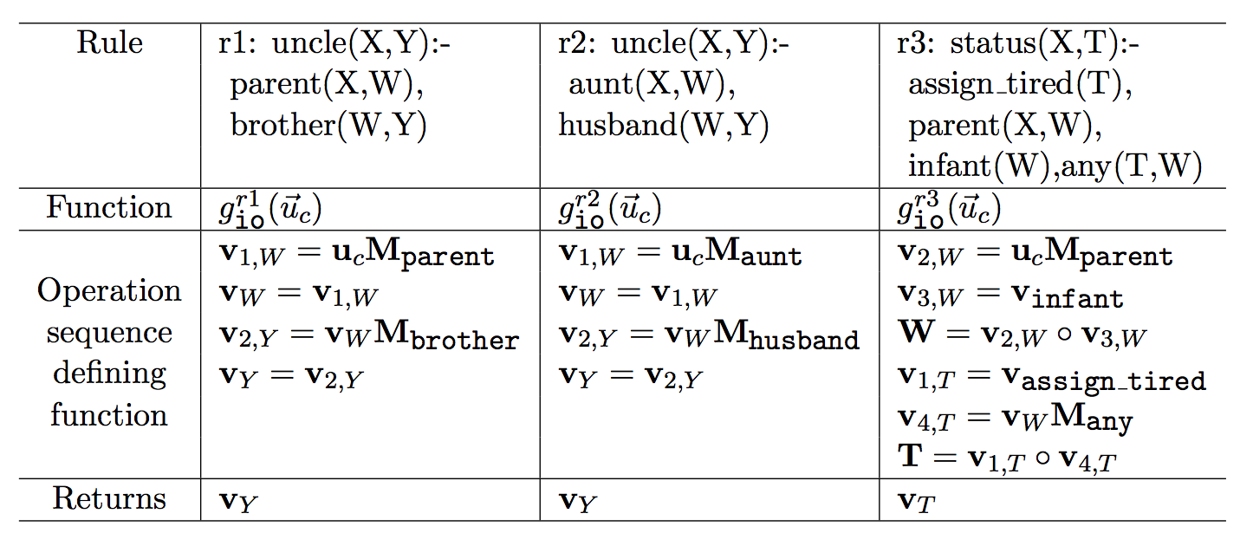
The result of this message-passing sequence produced by BP is just a function:
the function f_{p:io}(a) we were trying to construct!

Slide 24
Note on Semantics
The semantics are proof-counting, not model-counting: conceptually
For each answer a to query Q, find all derivations d_{a} that prove a
The weight of each d_{a} is product of weight w_{f} of each KG fact f used in that derivation
The weight of a is the sum of the weights of all derivations
This is an unnormalized stochastic logic program (SLP) - Cussens and Muggleton, with weights computed efficiently (for this special case) by dynamic programming (even with exponentially many derivations)

Slide 25
Note on Semantics
Compare to model-counting where conceptually
There is a distribution Pr(KG) over KGs
Tuple-independence: draw a KG by picking each fact f with probability w_{f}
The probability of a fact f’ is the probability T+KG’ implies f’, for a KG’ is drawn from Pr(KG)
E.g.: ProbLog, Fuhr’s Probabilistic Datalog (PD), ...

Slide 26
Tensorlog:
Learning Algorithms

Slide 27
Learning in TensorLog
Inference is now via a numeric function: y = g_{io}^{uncle}(u_{a})
y encodes {b:uncle(a,b)} is true and y[b]=confidence in uncle(a,b)
Define loss function relative to target proof-count values y* for x, eg
loss(g_{io}^{uncle}(u_{a}), y*) = crossEntropy(softmax(g(x)),y*)
Minimize the loss with gradient-descent, ….
To adjust weights for selected DB relations, e.g.: dloss/dM_{brother}

Slide 28
Key point: Learning is “free” in TensorLog
Inference is now via a numeric function: y = g_{io}^{uncle}(u_{a})
y encodes {b:uncle(a,b)} is true and y[b]=confidence in uncle(a,b)
Define loss function relative to target proof-count values y* for x, eg
loss(g_{io}^{uncle}(u_{a}), y*) = crossEntropy(softmax(g(x)),y*)
Minimize the loss with gradient-descent, ...
To adjust weights for selected DB relations, e.g.: dloss/dM_{brother}
Homegrown implementation: SciPy implementation of operations, derivatives, and gradient descent optimization
Compilation to TensorFlow expressions ⇒ TF derivatives, optimizers, ...

Slide 29
Tensorlog:
Experimental Results

Slide 30
Experiment: factual Q/A from a KB WikiMovies dataset
who acted in the movie Wise Guys? ['Harvey Keitel', 'Danny DeVito', 'Joe Piscopo', …]
what is a film written by Luke Ricci? ['How to Be a Serial Killer']
…
Data: from Miller, Fisch, Dodge, Karami, Bordes, Weston “Key-Value Memory Networks for Directly Reading Documents”
Questions: 96k train, 20k dev, 10k test Knowledge graph: 421k triples about 16k movies, 10 relations
Subgraph/question embedding:
93.5%
Key-value memory network:
93.9% “reading” the KG
76.2% by reading text of articles
starred_actors Wise Guys Harvey Keitel
starred_actors Wise Guys Danny DeVito
starred_actors Wise Guys Joe Piscopo
starred_actors Wise Guys Ray Sharkey
directed_by Wise Guys Brian De Palma
has_genre Wise Guys Comedy
release_year Wise Guys 1986
...

Slide 31
TensorLog model
# relations in DB = 9
who acted in the movie Wise Guys? ['Harvey Keitel', 'Danny DeVito', 'Joe Piscopo', …]
what is a film written by Luke Ricci? ['How to Be a Serial Killer']
…
starred_actors Wise Guys Harvey Keitel
starred_actors Wise Guys Danny DeVito
starred_actors Wise Guys Joe Piscopo
starred_actors Wise Guys Ray Sharkey
directed_by Wise Guys Brian De Palma
has_genre Wise Guys Comedy
release_year Wise Guys 1986
…
written_by How to .. Killer Luke Ricci
has_genre How to .. Killer Comedy
...
answer(Question, Entity) :-
mentions_entity(Question,Movie),
starred_actors(Movie,Entity),
feature(Question,F),weight_sa_io(F).
% w_sa_f: weight for starred_actors(i,o)
...
answer(Question, Movie) :-
mentions_entity(Question,Entity),
written_by(Movie,Entity),
feature(Question,F),weight_wb_oi(F).
...
Total: 18 rules

Slide 32
TensorLog model
k = # relations in DB = 9
who acted in the movie Wise Guys? ['Harvey Keitel', 'Danny DeVito', 'Joe Piscopo', …]
what is a film written by Luke Ricci? ['How to Be a Serial Killer']
…
answer(Question, Entity) :-
mentions_entity(Question,Movie),
starred_actors(Movie,Entity),
feature(Question,F),weight_sa_io(F).
% w_sa_f: weight for starred_actors(i,o)
...
answer(Question, Movie) :-
mentions_entity(Question,Entity),
written_by(Movie,Entity),
feature(Question,F),weight_wb_oi(F).
...
Total: 18 rules
These weights are a linear classifier that says which rule to use to answer which question

Slide 33
Experiment: Factual Q/A with a KB
KG is about 420k movie facts + 850k facts about the questions (mentions_entity/2, features/2)

Slide 34
Joint entity-linking and QA
proposed extension
answer(Question,Answer) :-
classification(Question,aboutActedIn),
mentionsEntity(Question,Entity), actedIn(Answer,Entity).
answer(Question,Answer) :-
classification(Question,aboutDirected),
mentionsEntity(Question,Entity), directed(Answer,Entity).
answer(Question,Answer) :-
classification(Question,aboutProduced),
mentionsEntity(Question,Entity), produced(Answer,Entity).
...
mentionsEntity(Question,Entity) :-
containsNGram(Question,NGram), matches(NGram,Name),
possibleName(Entity,Name), popular(Entity).
classification(Question,Y) :-
containsNGram(Question,NGram), indicatesLabel(NGram,Y).
matches(NGram,Name) :-
containsWord(NGram,Word), containsWord(Name,Word), important(Word).

Slide 35
Experiment: Relational Learning Benchmarks
Theories all learned using ISG (Wang et al, CIKM 2014) and then fixed

Slide 36
Experiment: Scalability of Inference
shallow inference task
deeply recursive inference task

Slide 37
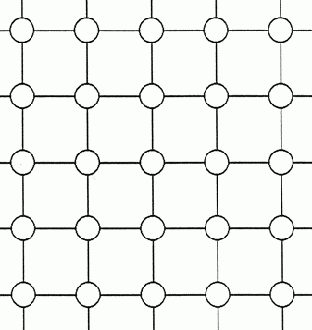
Experiment: Scalability of Inference
edge(cell_2_3, cell_2_4) 0.2
...
cell_2_3
cell_2_4
path(X,Y) :- edge(X,Y)
path(X,Z) :- edge(X,Z),path(Z,Y)

Slide 38
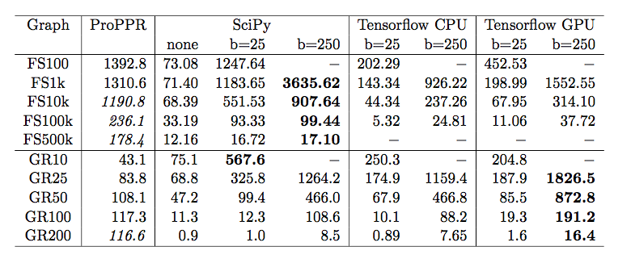
Experiment: Scalability of Inference
shallow
Queries per second: machine with one GPU
eg on query -? path(cell_2_4,Y)
bold is best TensorLog performer - ProPPR italicized if it “wins”
recursive

Slide 39
Experiment: Scalability of Inference
shallow
Queries per second: machine with one GPU
bold/italics is best performer
b=25 means that 25 queries are done in parallel (as a “minibatch”)
minibatch paralellization gives large - up to 10x - speedup on one core
recursive

Slide 40
Experiment: Scalability of Inference
shallow
Queries per second: machine with one GPU
bold/italics is best performer
b=25 means that 25 queries are done in parallel (as a “minibatch”)
Compared TensorFlow and homegrown sparse matrix backends ...
recursive

Slide 41
Experiment: Scalability of Inference
shallow
Queries per second: machine with one GPU (Titan X, 12Gb)
bold/italics is best performer
b=25 means that 25 queries are done in parallel (as a “minibatch”)
Tested TensorFlow and hand-constructed sparse matrix backends
Tested TensorFlow with GPU: only 1.5-2x faster for inference and then only on deeper models
recursive

Slide 42
Experiment: Scalability of Learning
Task: learn grid transition weights so that transitive closure operations perform a particular navigational goal
Go from cell to closest “landmark” cell, like (10,10) or (30,50)
Minibatch size of 25
A 25 by 25 grid
Learning is much faster with TensorFlow and with GPUs
Architected for learning/repeated passes over data with same code

Slide 43
Experiment: Robustness of Learning
Tune parameters on 16x16 grid task
Run same parameters on larger grids (deeper inference, different architecture networks)
Compare homegrown gradient descent and well-tuned Adagrad (Tensorflow implementation)
Adagrad is more robust and faster

Slide 44
Tensorlog:
Extensions

Slide 45
Experiment: Learning Other Semantics
Inference is now via a numeric function: y = g_{io}^{uncle}(u_{a})
y encodes {b:uncle(a,b)} is true and y[b]=confidence in uncle(a,b)
Define loss function relative to target proof-count values y* for x, eg
loss(g_{io}^{uncle}(u_{a}), y*) = crossEntropy(softmax(g(x)),y*)
softmax normalizes the proof counts y
so you learn a conditional distribution P(y|x)
i.e. sum of y’s will be 1.0
can rank people by confidence in being “Bob’s uncle” but can’t tell how many uncles Bob has
(but it’s great to optimize!)

Slide 46
Key point: flexibility is free
Adding logistic
regression
“on top” of TensorLog
Inference is now via a numeric function: y = g_{io}^{uncle}(u_{a})
y encodes {b:uncle(a,b)} is true and y[b]=confidence in uncle(a,b)
Define loss function relative to target proof-count values y* for x, eg
loss(g_{io}^{uncle}(u_{a}), y*) = crossEntropy(sigmoid(g(x) + b), y*)
Alternative: convert weighted proofcounts to an arbitrary distribution - e.g. with a biased sigmoid - and assess loss relative to that. Loss function changes, learning still “free”.
Then you can learn to match an arbitrary target distribution.

Slide 47
Example: alternative semantics
Recall proof-counting was compared to model-counting systems (eg ProbLog2) where conceptually
There is a distribution Pr(KG) over KGs
Tuple-independence: draw a KG by picking each fact f with probability w_{f}
The probability of a fact f’ is the probability T+KG’ implies f’, for a KG’ is drawn from Pr(KG)
Experiments: for grid world, estimate Pr(path(a,b)) using a sample of 1M random KG/grids drawn from the tuple-independence model

Slide 48
Experiment: Learning Alternate Semantics
Experiment: learn grid-transition weights to approximate ProbLog2’s inference weights.
Error drops by factor of 10x.

Slide 49
Experiment: Learning Alternate Semantics
Experiment: learn grid-transition weights to approximate ProbLog2’s inference weights.
Error drops by factor of 10x.

Slide 50
Experiment: Learning Representations
edge(cell_2_3, cell_2_4) 0.2
...
cell_2_3
Replace learnable weight 0.2 with a function of learned representations of cell_2_3 and cell_2_4.
Each cell i has a learned vector representation ei
cell_2_4
path(X,Y) :- edge(X,Y)
path(X,Z) :- edge(X,Z),path(Z,Y)

Slide 51
Experiment: Learning Representations
Experiment: learn a neural model for grid-transition weights.
edge(cell1, cell2) =
log(1 + exp(sum_d (e1[d] - e2 [d])) * M[cell1,cell2]
makes edge score positive
Averaged over 10 trials, 10x10 grid, 100 epochs.
Accuracy 97.8%
Accuracy of baseline: 85.8%
(one weight per edge)
0,1 mask so only grid edges are considered
Manhattan distance in embedding space, but directional: want weights to encourage transitions toward the target cell.

Slide 52
Tensorlog:
Extension (Neural ILP)
Fang Yang, Zhilin Yang

Slide 53
Learning rules for TensorLog
Given only examples:
uncle(liam,Y): Y should be {“bob”}
aunt(liam,Y):Y should be {“mary, “sue”}
…
Learn full model (parameters and rules)
Basic idea:
TensorLog programs are compiled to a sequence of differentiable operators
Each operator is applied to a memory location ~= logical variable
Learn sequence with a neural controller

Slide 54
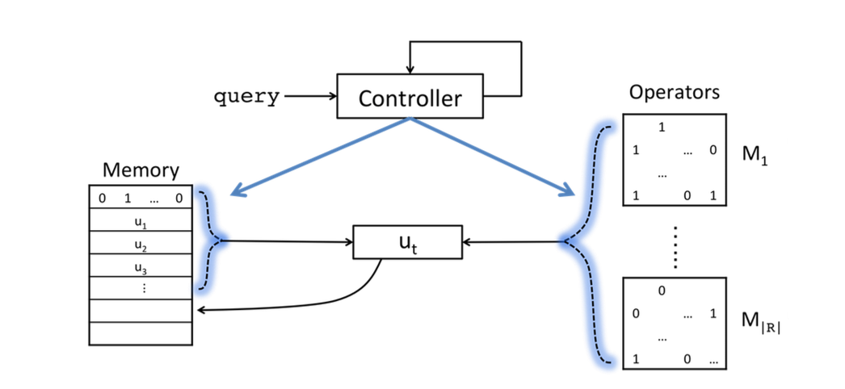
Learning rules for TensorLog
Final output is attention over memory cells after T steps
LSTM controller: reads p,a at each time step in computing Y : p(a,Y)
Current status:
chain rules only,
hard KB
New memory cell allocated at each time step: contents are formed by attention over ops and previous memory cells

Slide 56
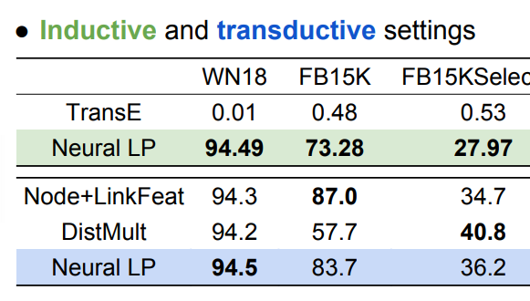
Results for Neural Inductive Logic Programming

Slide 57
Recovering rules for Neural ILP

Slide 58
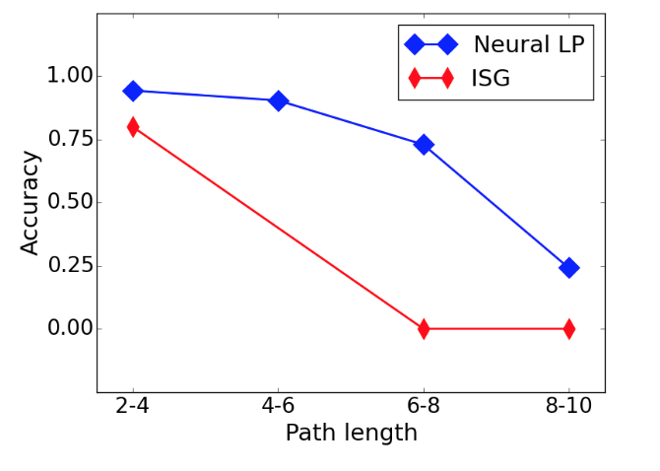
Results for Neural Inductive Logic Programming
Synthetic task: learning specific long paths in grid, like “NE-NE-S-S”

Slide 59
Where to next?
William Cohen
Google AI

Slide 60
TensorLog model
who acted in the movie Wise Guys? ['Harvey Keitel', 'Danny DeVito', 'Joe Piscopo', …]
what is a film written by Luke Ricci? ['How to Be a Serial Killer']
…
starred_actors Wise Guys Harvey Keitel
starred_actors Wise Guys Danny DeVito
starred_actors Wise Guys Joe Piscopo
starred_actors Wise Guys Ray Sharkey
directed_by Wise Guys Brian De Palma
has_genre Wise Guys Comedy
release_year Wise Guys 1986
…
written_by How to .. Killer Luke Ricci
has_genre How to .. Killer Comedy
...
answer(Question, Entity) :-
mentions_entity(Question,Movie),
starred_actors(Movie,Entity),
feature(Question,F),weight_sa_io(F).
% w_sa_f: weight for starred_actors(i,o)
...
answer(Question, Movie) :-
mentions_entity(Question,Entity),
written_by(Movie,Entity),
feature(Question,F),weight_wb_oi(F).
...
Total: 18 rules

Slide 61
TensorLog model
Is this the best interface to give Google programmers to build models? Problems:
Hard to predict what will happen in the compiled model (what does the BP stage do to construct a model?)
Hard to quantify over relations (do second order reasoning)
Awkward to swap back and forth between TensorFlow and TensorLog (declarative vs functional)
Proposal: language for compilation target for Tensorlog
answer(Question, Entity) :-
mentions_entity(Question,Movie),
starred_actors(Movie,Entity),
feature(Question,F),weight_sa_io(F).
% w_sa_f: weight for starred_actors(i,o)
...
answer(Question, Movie) :-
mentions_entity(Question,Entity),
written_by(Movie,Entity),
feature(Question,F),weight_wb_oi(F).
...

Slide 62
Neural Query Language: 1st-order
-1: go “backwards”
mode oi
answer =
question.mentions_entity().starred_actors().if_exists(
question.feature() & nq.one(‘starred_actors’).indicates(-1))
| question.mentions_entity().directed_by().if_exists(
question.feature() & nq.one(‘directed_by’).indicates(-1))
|
….
answer(Question, Entity) :-
mentions_entity(Question,Movie),
starred_actors(Movie,Entity),
feature(Question,F),
indicates(F,’starred_actors’).
...
answer(Question, Movie) :-
mentions_entity(Question,Entity),
written_by(Movie,Entity),
feature(Question,F),
indicates(F,’written_by’)
...
“features that indicate the ‘starred_actors’ KG relation”
“features that indicate the ‘directed_by’ KG relation”
x.if_exists(y): return vector x multiplied by sum of weights in y … a soft version of return x iff y is non-empty else empty set

Slide 63
Neural Query Language: 1st-order
answer =
question.mentions_entity().starred_actors(+1).if_exists(
question.feature() & nq.one(‘starred_actors’).indicates_rel(-1)).if_exists(
question.feature() & nq.one(‘forward’).indicates_dir(-1)))
| question.mentions_entity().starred_actors(-1).if_exists(
question.feature() & nq.one(‘starred_actors’).indicates_rel(-1)).if_exists(
question.feature() & nq.one(‘backward’).indicates_dir(-1)))
….
answer(Question, Entity) :-
mentions_entity(Question,Movie),
starred_actors(Movie,Entity),
feature(Question,F),
indicates_rel(F,’starred_actors’),
indicates_dir(F,’forward’).
...

Slide 64
NQL: semantics in Tensorflow
variable/expression output x | a vector encoding a weighted set (localist representation)
nq.one(‘bob’,’person’) x.jump_to(‘bob’,’person’) | v_bob, one hot vector for entity ‘bob’
nq.all(‘person’) x.jump_to_all(‘person’) | k-hot vector for set off all elements of type ‘person’ i.e. a ones vector
nq.none(‘person’) x.jump_to_none(‘person’) | k-hot vector for empty set of elements of type ‘person’ i.e. a zeros vector
x.r() x.follow(‘r’) | x.dot(M_r) where M_r is sparse matrix for r and x a k-hot vector
x | y x + y | x + y
x & y x * y | x * y Hadamard aka component-wise product
x.filtered_by(‘r’,’bob’) x.weighted_by(‘r’,’bob’) | x * v_bob.dot(M_r’) M_r’ is transpose
x.if_exists(y) x.weighted_by_sum(y) | x * y.sum()

Slide 65
Neural Query Language: 2nd-order
def kg_relation(question):
return question.features().feat2rel() % classify relation
def answer(question):
return question.mentions_entity().follow(kg_relation(question))
verb(t37,starred_in)
starred_in(tom_hanks,the_post) → subject(t37,tom_hanks)
object(t37,the_post)
x.follow(g) == (x.subject(-1) & g.verb(-1)).object()
x={tom_hanks} g={starred_in}: (tom_hanks is sub) & (starred_in is verb) → object

Slide 66
Conclusions and Wrap-Up

Slide 67
Conclusions and Wrap-Up

Slide 68
Conclusions and Wrap-Up
How should logic and logic programming approaches to AI be integrated with “neural” / “deep” / GPU-based approaches to AI?

Slide 69
Conclusions and Wrap-Up
How should logic and logic programming approaches to AI be integrated with “neural” / “deep” / GPU-based approaches to AI?
TensorFlow tries to answer this in one way:
Scalable - but restricted - declarative subset of Prolog
Very efficient for learning and inference
Combinable with neural methods:
Eg: Logistic regression model “on top” of proof counts (for tuple-independence)
Eg: Representation learning “underneath” (to define edge weights)

